Slide 1
AI AGENT-BASED
SUDOKU SOLVER

Slide 2
Meet the team
Group 2
Sabiqun Nahar Ritu
ID : 2021597042
Md. Shakibur Rahman
ID : 2013534042
Rifa nanziba keka
ID : 2021936642

Slide 3
INTRODUCTION & OBJECTIVE
• Sudoku → logic-based puzzle solved via constraints.
• Goal: Build an AI agent to solve Sudoku efficiently with an interactive GUI.
• Approach:
• CSP + Backtracking
• Forward Checking + Heuristics
• GUI using Tkinter
Group - 2
Sabiqun Nahar Ritu
ID : 2021597042
Md. Shakibur Rahman
ID : 2013534042
Rifa nanziba keka
ID : 2021936642

Slide 4
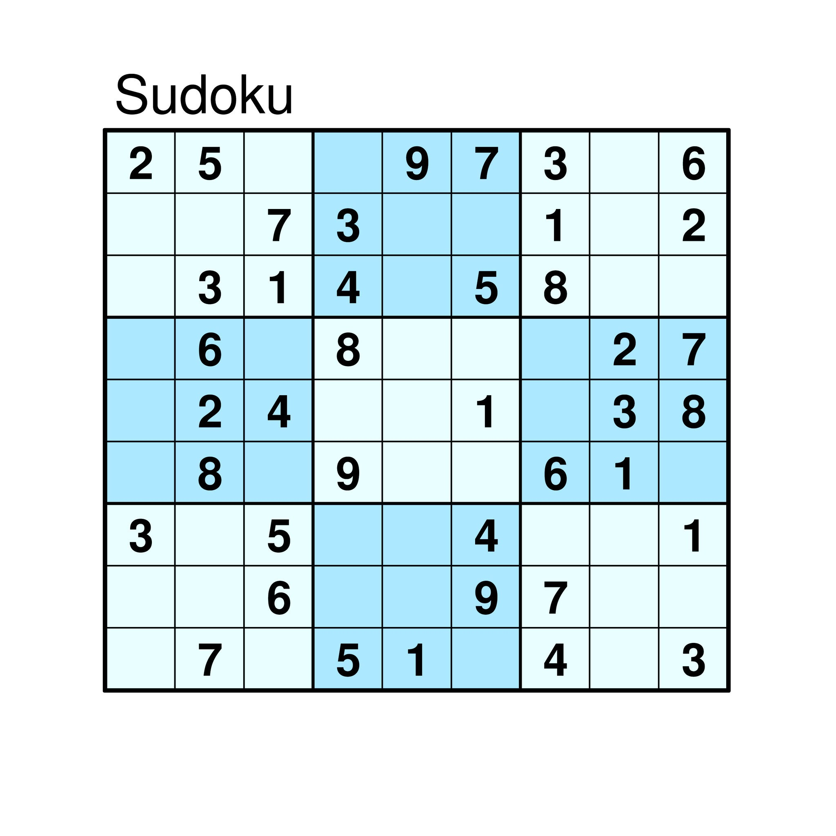
SUDOKU AS CSP
• Each of 81 cells = a variable.
• Domain = digits 1–9 (or pre-filled).
• Constraints:
• No repeats in rows, columns, or 3×3 subgrids.
• Solution = all constraints satisfied.
Group - 2
Sabiqun Nahar Ritu
ID : 2021597042
Md. Shakibur Rahman
ID : 2013534042
Rifa nanziba keka
ID : 2021936642

Slide 5
AI TECHNIQUES
• Backtracking: Try values, revert if invalid.
• Forward Checking: Prune impossible values early.
• MRV Heuristic: Pick the cell with fewest options first.
• Together → reduce search space, solve faster
Group - 2
Sabiqun Nahar Ritu
ID : 2021597042
Md. Shakibur Rahman
ID : 2013534042
Rifa nanziba keka
ID : 2021936642

Slide 6
ALGORITHMS OVERVIEW
• Forward Checking
Eliminates invalid values from related cells after each assignment.
Early backtracking if a domain becomes empty.
• Backtracking Search
Fills empty cells by trying numbers 1–9.
Retraces steps when a conflict arises.
• MRV Heuristic (Minimum Remaining Values)
Chooses the cell with the fewest valid options.
Reduces unnecessary guesses and speeds up solving.
Group - 2
Sabiqun Nahar Ritu
ID : 2021597042
Md. Shakibur Rahman
ID : 2013534042
Rifa nanziba keka
ID : 2021936642

Slide 7
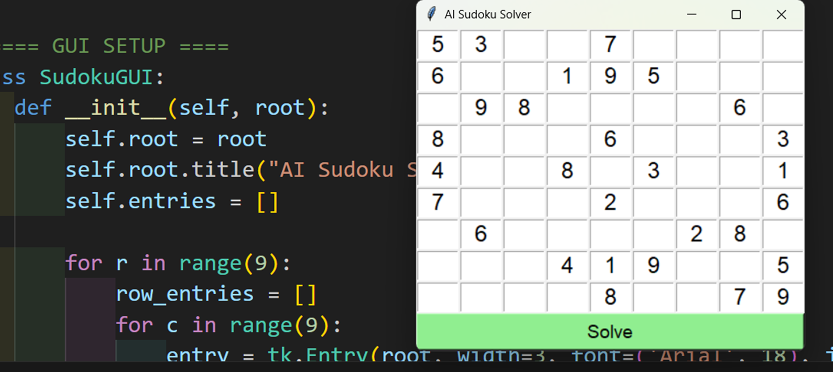
GUI DESIGN
• Built with Tkinter.
• 9x9 grid for user input.
• Solve button activates AI solver.
• Displays solution on the same interface with a simple, clean layout.
Group - 2
Sabiqun Nahar Ritu
ID : 2021597042
Md. Shakibur Rahman
ID : 2013534042
Rifa nanziba keka
ID : 2021936642

Slide 8
ADVANTAGES & USE CASES
Advantages
• Always finds a solution if one exists
• Efficient with propagation + heuristics
• Systematic and easy to scale
Use Cases
• Sudoku solvers
• N-Queens and similar CSP puzzles
• Crosswords, timetabling, and general CSPs
Group - 2
Sabiqun Nahar Ritu
ID : 2021597042
Md. Shakibur Rahman
ID : 2013534042
Rifa nanziba keka
ID : 2021936642

Slide 9
CONCLUSION & NEXT STEPS
Conclusion
• Applied CSP with backtracking and heuristics to solve Sudoku
• Achieved efficient solving with a simple GUI
Next Steps
• Improve GUI with highlighting
• Add puzzle generator
• Extend to larger boards (e.g., 16×16)
• Test advanced methods (AC-3, genetic algorithms, ML heuristics)
Group - 2
Sabiqun Nahar Ritu
ID : 2021597042
Md. Shakibur Rahman
ID : 2013534042
Rifa nanziba keka
ID : 2021936642

Slide 10
Thank you!

